Slide 1

Avocado Sales in the United States from 2017 to 2020
Capstone 1 Oscar E. Castro

Slide 2
Project Background
In recent years, avocados have become a widely popular fruit in the United States. With this project we are interested in understanding the magnitude of this industry in the country and we aim to describe and analyze the trends in major cities of the United States. More specifically, whether marketers could experience an increase in revenue through the implementation of either higher spending on promotion or increased pricing.
This project consists of public data published by the Hass Avocado Board on their website. Our project uses a sample of 45 major US cities and the first 20 weeks of each year from 2017 to 2020. The data is also divided by avocado type, conventional or organic, although this presentation will focus mostly on conventional avocados. Our data also consists of 3 different PLUs and 3 bags of avocados based on their size. The data contains Average Selling Price (ASP) for each week and each city and the following are the PLUs based on the size of the unit.
PLU 4046: Small
PLU 4225: Large
PLU 4770 : Extra Large

Slide 3
Total sales of conventional avocados by PLU from 2017 to 2020
The two most common sizes of conventional avocados are Small and Large, both in bulk and bagged.
Additionally, we see that the Small and Large conventional units have steadily become more popular in the last four years, particularly in 2020.
Bagged sales of Large units had their biggest increase (63%) in 2020 compared to 2019.

Slide 4
Organic avocados are more popular when sold in bags
On the other hand, organic avocados are less popular sold individually compared to conventional avocados, yet sales of bagged units in 2020 have increased by 32% for small avocados compared to 2019 and large avocados increased by 128%.

Slide 5
Total Units Sold Continues Increase in 2020
Combined total sales have been increasing since 2017.
After slow sales growth in 2019, combined sales increased by 9.1% in 2020.
Although organic avocados sales growth increased by 26.8%, combined growth was mostly driven by the high volume of conventional avocado sales which increased by 8.4%.
The following slides will only focus on conventional avocados due to their magnitude.

Slide 6
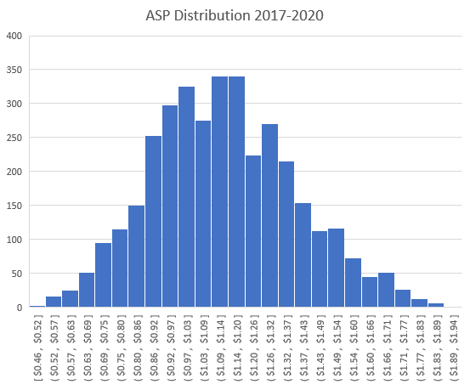
Conventional ASP has a normal distribution between 2017 and 2020
We see that conventional avocados ASP has a normal distribution with a standard deviation of .25 cents which indicates prices have been more spread out and have higher variability rather than clustered close to the mean of $1.13 between 2017 and 2020.
Mean = $1.13
Median = $1.12
Mode = $1.14
Standard Deviation = $0.25
Range = $1.47
Minimum = $0.46
Maximum = $1.93

Slide 7
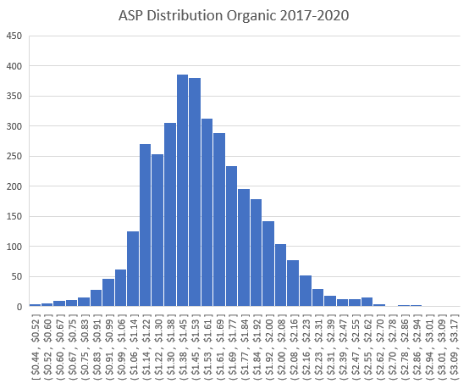
ASP distribution of organic avocados from 2017 to 2020
Organic avocados have had an even higher standard deviation and prices have higher variability. As one may expect, price range, mean and median are higher than conventional avocados as well.
Mean = $1.54
Median = $1.51
Mode = $1.38
Standard Deviation = $0.34
Range = $2.73
Minimum = $0.44
Maximum = $3.17

Slide 8
Super Bowl and Cinco de Mayo have constant spikes in consumption of conventional avocados
After analyzing the total sales per week, we realize that week 5 and week 18 are two weeks in which avocado sales follow a trend.
Week 5 consistently falls on the week heading into the Super Bowl, while week 18 is the first week of May, or the week around May-5th (“Cinco de Mayo”).

Slide 9
Discounted Conventional ASP in Week 5 and Week 18
We also analyzed the Average Selling Price (ASP) reported each week and realized that ASP follows a similar pattern than Total Sales in week 5 and week 18.
The trend in this case is a lower ASP during these two weeks.
In 2020, on average, the ASP was reduced by 16% in week 5 while jumping 15% in week 6 and a 10% reduction in ASP in week 18 while recovering only 4% in week 19. We assume that it is not a problem of supply shortages but rather a strategy to create demand.

Slide 10
Estimated Revenue increases in 2020
We see that Revenue follows a similar pattern than the Total Unit Sales chart with two spikes in Week 5 and Week 18.
We also see that 2020 has had a steady incline as it separates from the previous 3 years and revenue increased by approximately $10M USD or about 32% in week 11.
Although we didn’t study the impact of COVID-19 in the avocado industry, week 11 was around the same time the US started to order lockdowns due to the pandemic.

Slide 11
Total Units Sold and Revenue Have a Strong Correlation for Conventional Avocados
As we compared ASP and Total Units Sold in previous slides, we wanted to understand how they correlated with each other.
The first chart shows us that ASP and Total Units Sold are not correlated and that the data points are scattered with no linear relationship; this means that a higher price does not necessarily mean less units sold.
On the other hand, we see that an increase in Total Units Sold represents an increase in Revenue, with a strong positive correlation of 0.9299 which means 93% of our data points for total units sold can explain higher revenue.

Slide 12
ASP for Organic Avocados is lower in 2020
As we mentioned before in our histogram, 2017 had higher prices of organic avocados, particularly in April and May, while 2020 had the 20-week average ASP reduced by 6% compared to 2017.
Although the pattern is less noticeable, week 5 and week 18 also brought discounted ASPs for organic avocados.

Slide 13
Consumption of Organic Avocados increased in 2020
2020 has been a good year for organic avocados as consumption has more than doubled compared to 2017, likely due to lower prices as we mentioned on the previous slide.

Slide 14
Conventional and Organic Avocados follow similar economic behaviors
We see that Estimated Revenue for organic avocados follows a similar pattern for Total Unit Sales and that 2020 has brought in more revenue, even though ASP has been decreasing in the last four years.
The behavior of these variables follow the one of conventional avocados.
Lower ASP produces higher demand for the fruit, which generates increased revenue.

Slide 15
Total Unit Sold and Revenue for Organic Avocados Also Have a Strong Correlation
Scatter Plots and Correlations between ASP, Total Units Sold, and Revenue for organic avocados are very similar to the ones for conventional avocados. Therefore our preliminary conclusion remains unchanged.

Slide 16
Conclusion and Next Steps
We saw that avocado sales follow a clear trend in specific holidays happening in the first 20 weeks of each year.
We also see that there is no correlation between Selling Price and Total Units Sold, which means consumers are more likely to continue to buy avocados even if prices are higher or constant to previous weeks.
We believe that marketers have an opportunity to capitalize on the demand already created in the last four years by offering fewer steep discounts in cities with higher constant demand. We believe the increase in units sold should be driven mostly by increased promotion rather than by discounted price on weeks surrounding the holidays.
Furthermore, we believe it’s worth looking into which cities have constant demand and recommend as next steps studying the population and demographics of the consumers. Quick questions come to mind, such as, how many avocados are being bought per household in each city? Or, is the city demand due to higher population density rather than a higher number of avocados per capita?

